Slide 1
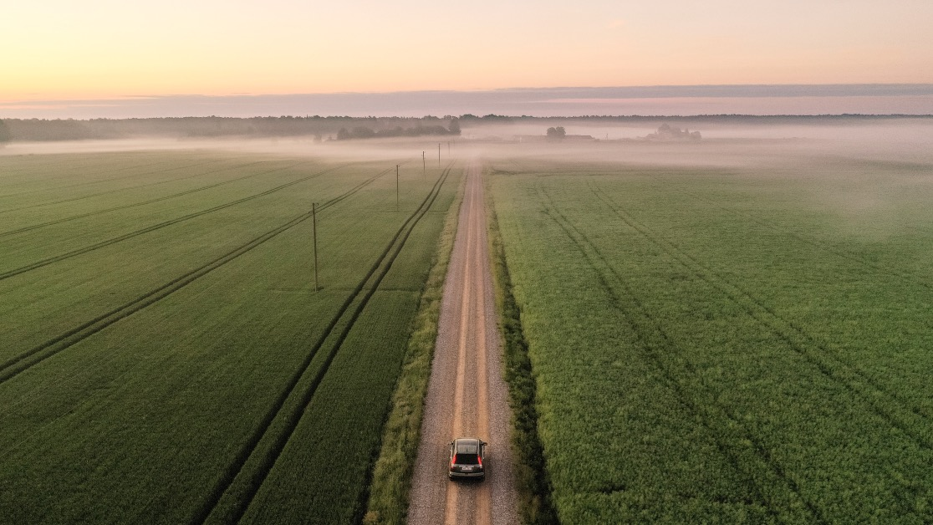

GPS and Dash Cams
Ryan McDonald 10/29/2025

Slide 2
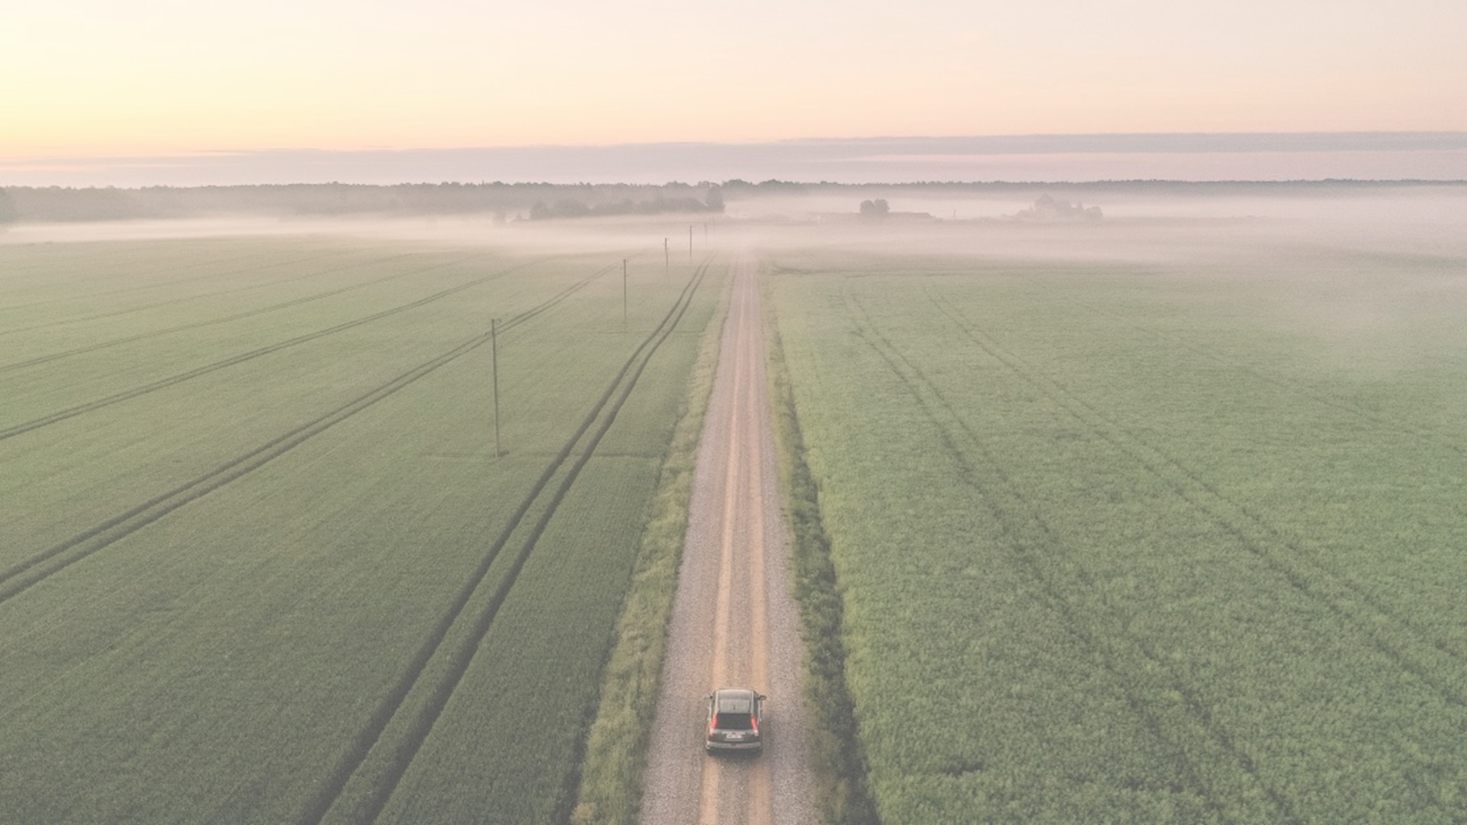


Todays Agenda
Who We Are
GPS and Camera Info
Why Companies / Drivers Need Cameras
Implementation with Insurance companies

Slide 3




Who We Are
Is My Driving Safe / RPM Global Connect
20 Plus Years in Fleet Industry From:
Call Center Solutions, Decals, (Is My Driving Safe) Driver Surveillance, Target Surveillance, GPS, Dashcams, Now A.I.
Reseller for Road Eazy, EZ Fleet and Azuga’s: GPS and Dashcams
Preferred GPS / Camera Vendor for QEO Insurance

Slide 4

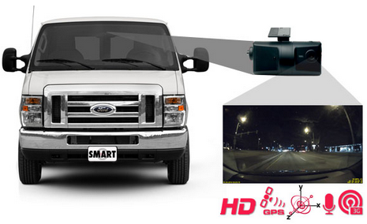

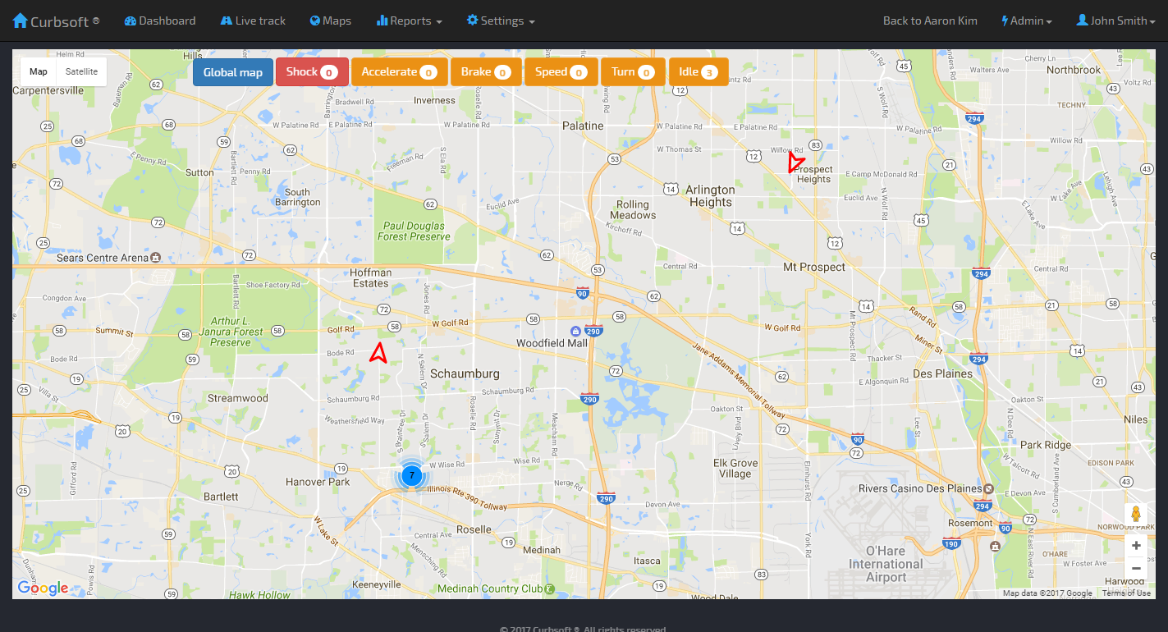
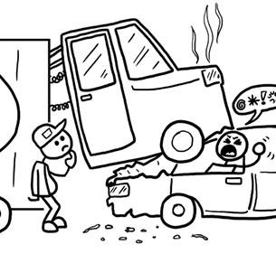
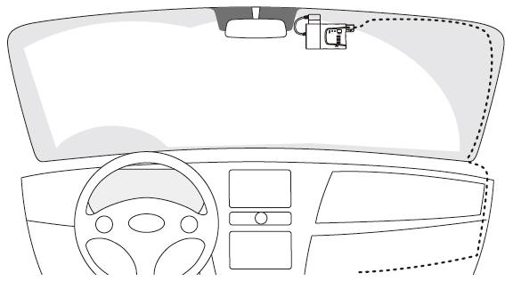
Video Telematics Technology Overview
Cellular
Transfer
Cameras are Connected to the windshield. GPS’s mounted underneath and hidden away
Login- Real Time Locations
web browser
or phone App
with simple login.
Event occurs
Camera records HD video
SIM Card Backup
The Events and Locations are sent to our Cloud.
1 year and able to go back forever

Slide 5
GPS and Dash Cams Reseller
As a Reseller for Camera and Telematics
Top Level Customer Service - Me
Custom Fit GPS – Dashcams to customers:
GPS - Plug-N-Play and Hardwired Options
Computer and Cell Phone (APP) Dashboards
3 Different Camera Options
ELD
A.I. Driver warninig

Slide 6
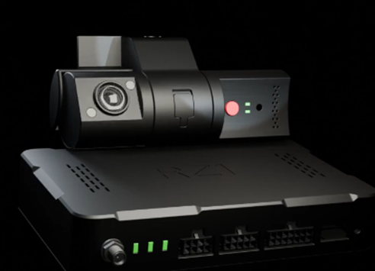
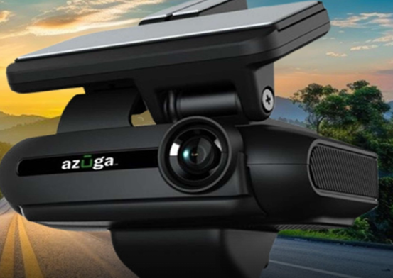
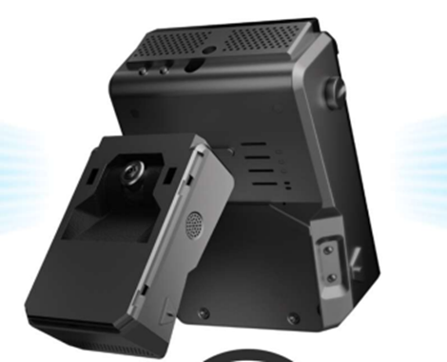
A.I Cameras –Benefits / Features
Real-time access to LIVE video of the road and driver
Facial recognizes driver distraction at any hour of the day
A.I powered built in sensors detect harsh driving incidents including driver distractions
AI Driver Assistance provides real-time audio feedback and visual warnings for dangerous driving events
On-Demand Video retrieval from the cloud
Additional auxiliary camera support: Rear, side views
SIMPLE SETUP Designed for a simple installation with mounting
PANIC BUTTON The SOS button allows you to send predefined alerts and auto-upload video event to the cloud
FUTURE PROOF 3G/4G/5G connectivity are built in
TAMPER RESISTANT Tamper resistant SIM and 128 GB SD card slot, secured with safety screws
VIDEO RECORDING Auto-upload video events to the cloud over 3G/4G/5G network and record video continuously on SD card

Slide 7
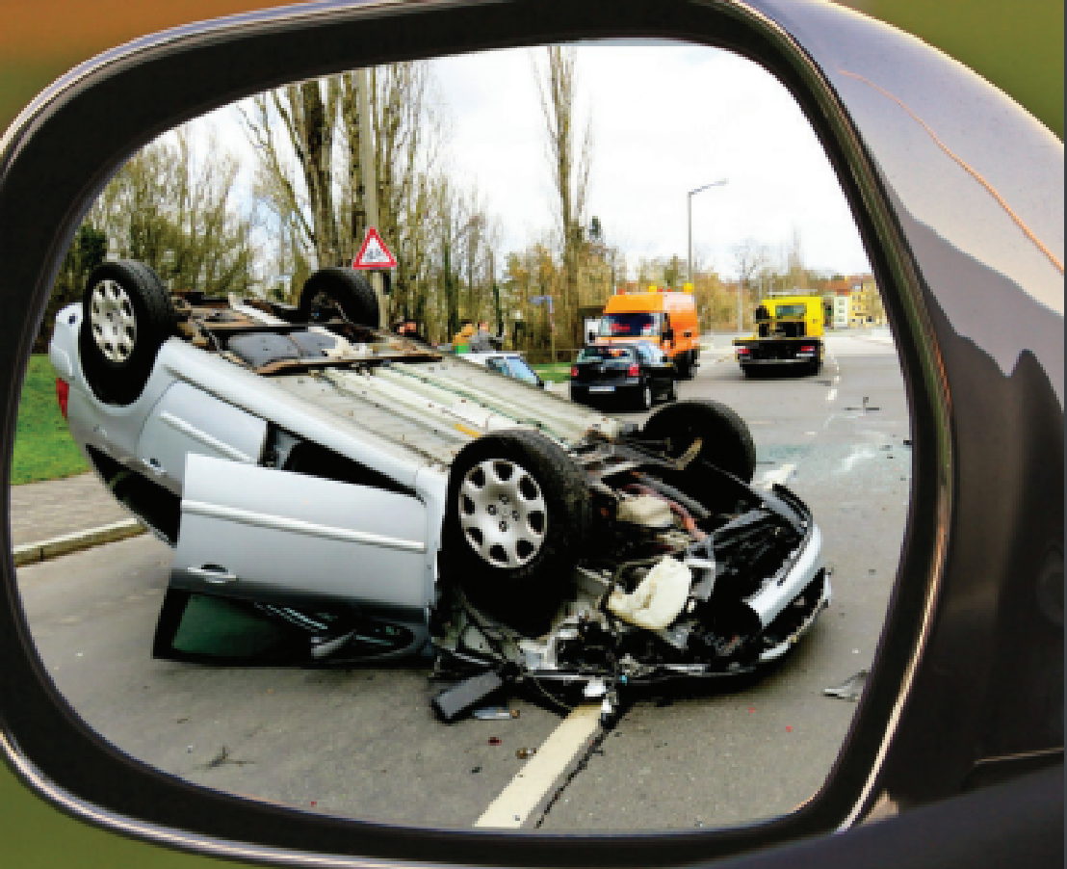

Type of Accidents
Not At Fault
72% of Accidents Not the Fault of Your Drivers (Everest / QEO Insurance)
Companies/Fleets are traveling billboards and are aggressively sued
50% Driver Exonerated
Without VIDEO proof, it is very hard to win a litigation
At Fault (Avoidable) – Our A.I Camera improves avoidable accidents
60% Enhanced Driver Behavior
By Alerting - Aggressive and Distracted Driving – accidents decrease
The odds of having an accident are 4x greater when using a cell phone.
It Alerts Cell Phone Usage, Driver Fatigue, Tailgating, Speeding
It Also Alerts Rapid Acceleration and Deceleration

Slide 8
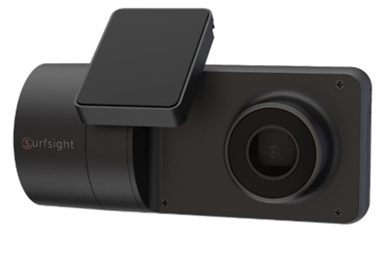
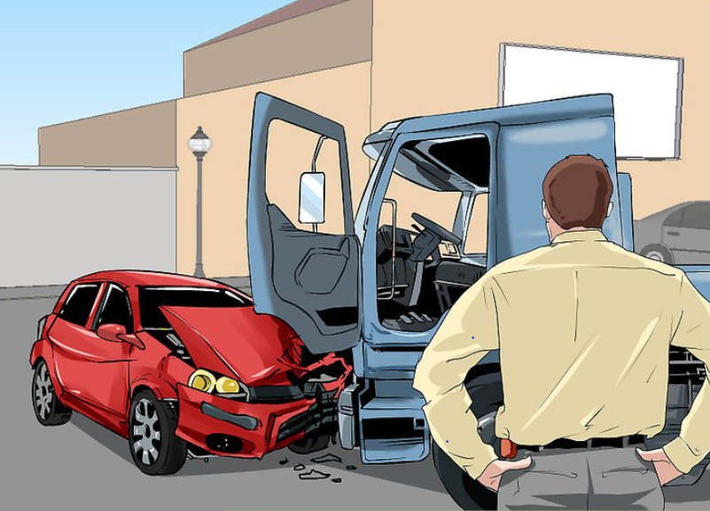
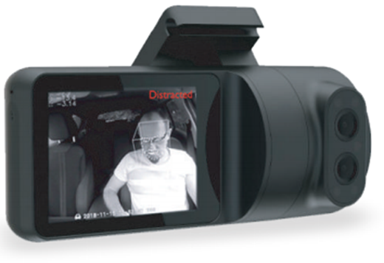
GPS and Dash Cams -Why Do Dashcams Work?
Dashcams and GPS’s- Help to Create a Safety Culture.
Our A.I cameras have real-time coaching and alerting for distracted driving, tailgating etc.
By Beeps and audio - Drivers will regain focus on the road - All BEFORE ACCIDENTS HAPPEN!
By Installing (and USING) - Drivers will Decrease Avoidable Accidents by Changing Behaviors! Instantly when alerted
With the GPS - Instantly View drivers location, stops, speeds, ideling etc.
Track and Reporting : every mile, every stop, 54 reports.
Drivers - FIRST LINE OF DEFENSE
Not At Fault Accidents- Will Be Proven - Use Video to Coach and Exonerate
At Fault Drivers- Insurance Companies and Attorneys know how to evaluate the accident and settle quicker
Reduce the risk and cost of accidents
Controlling the exposure to Nuclear Verdicts
Prevent frivolous claims and exonerate

Slide 9
Case Study: Fire Safety Management (245 Vehicles)
April 2016 to April 2017
Before Dash Cams
April 2017 to April 2018
1st year
April 2018 to April 2019
2nd Year
22 at fault accidents
Insured loss
$336,000
Insurer Annual Savings
(Including Dash Cam Annual Fee*)
$538,000
8 at fault accidents
Insured loss
$73,000
Insurer Annual Savings
(Including Dash Cam Annual Fee*)
$801,000
37 at fault accidents
Insured loss
$914,000
*Insurance partner estimated annual Camera Fees for this fleet = $40,000
Notes:
All use cases need consistent format.
The “thank you letter” numbers were for January to September and their insurance renewal dates run from April to April.
Insurance partner annual Azuga Fee for this account = $39,200
Before Azuga (baseline): 4/2016 to 4/2017 37 at fault accidents for an insured loss of $914,000
Fleet out of pocket = $185,000
They started with Azuga on 2/28/2017 and were slow to buy in at first, but their at fault accidents for 4/2017 to 4/2018 went down to 22 for an insured loss of $336,000
Insurance Partner Annual Savings = $578,000 - $39,200 (Azuga annual fee) = $538,800
Fleet out of pocket = $110,000. Fleet Savings = $75,000
From 4/2018 to 4/2019 they had only 8 at fault accidents with an insured loss of $73,000
Insurance Partner Annual Savings = $841,000 - $39,200 (Azuga annual fee) = $801,800
Fleet out of pocket = $40,000. Fleet Savings = $145,000

Slide 10
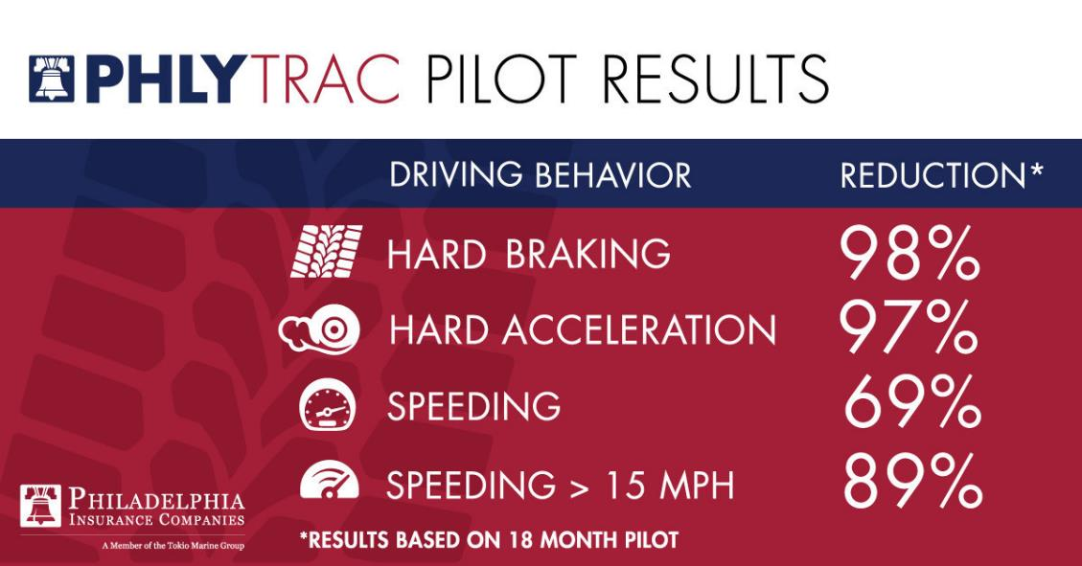
Proof is in the Numbers! Cameras Work
50%+ REDUCTION IN THE FREQUENCY AND SEVERITY OF ACCIDENTS
Notes:
All use cases need consistent format.

Slide 11
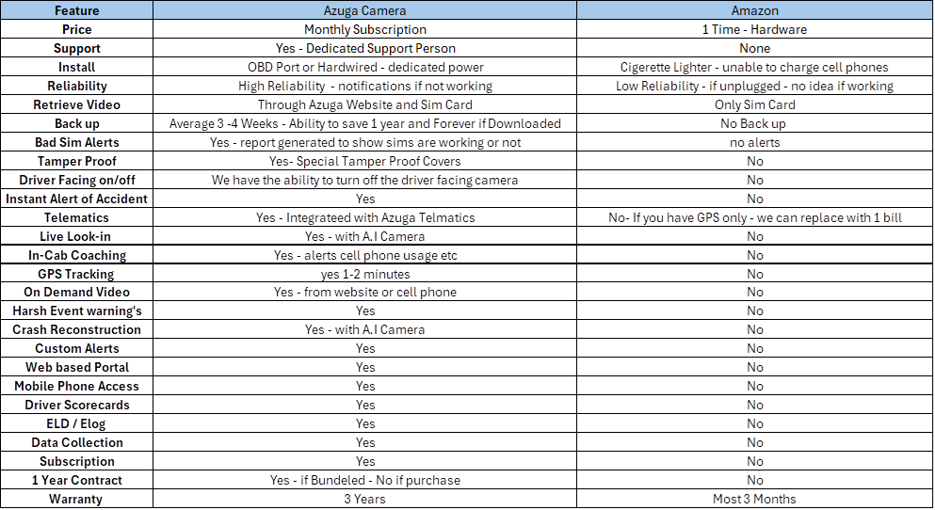
Difference vs Cloud Based A.I Cameras and Generic Amazon-
Cloud Based A.I Cam !!!!!!!

Slide 12
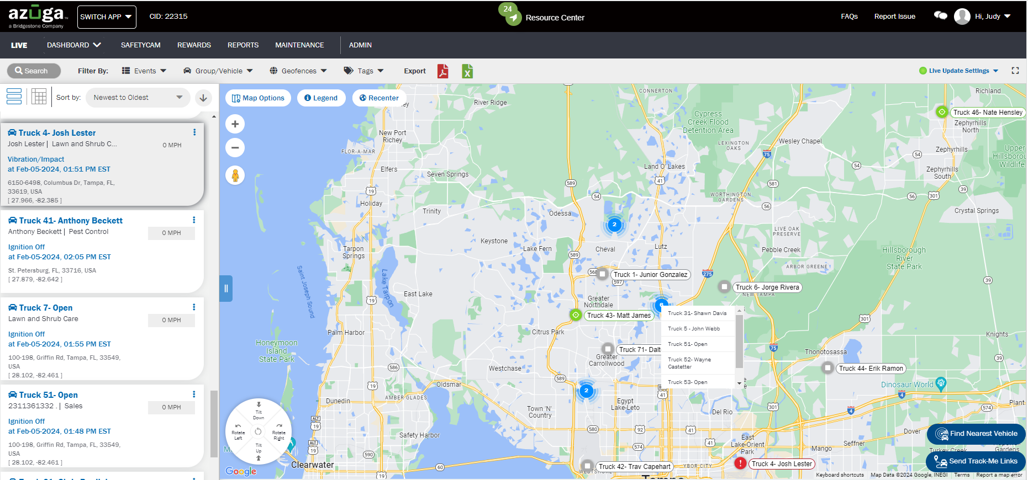
GPS and Camera Dashboard

Slide 13
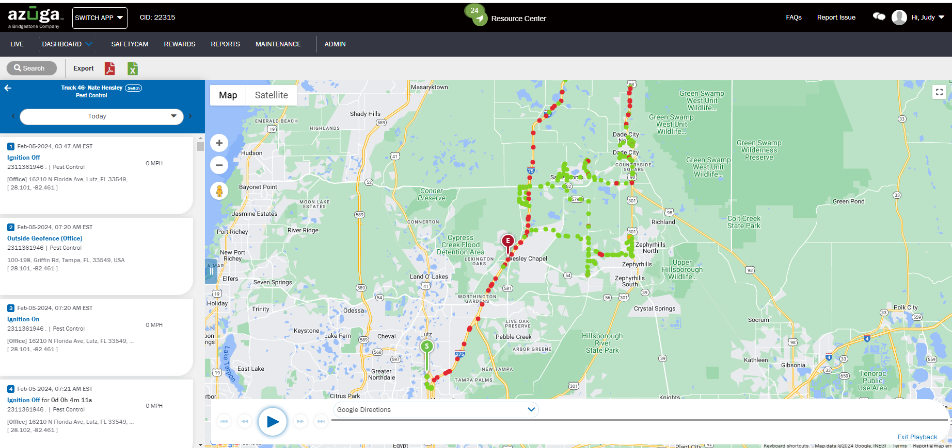
GPS and Camera Dashboard – Breadcrumb - Trails

Slide 14
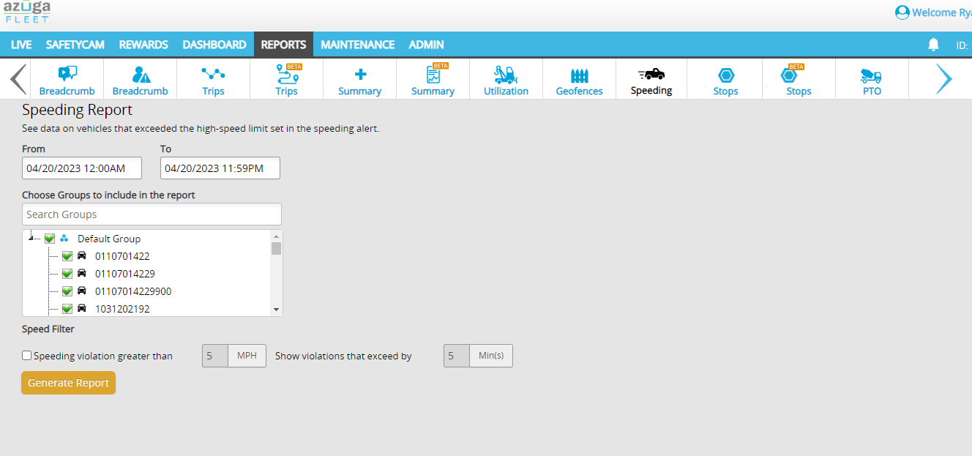
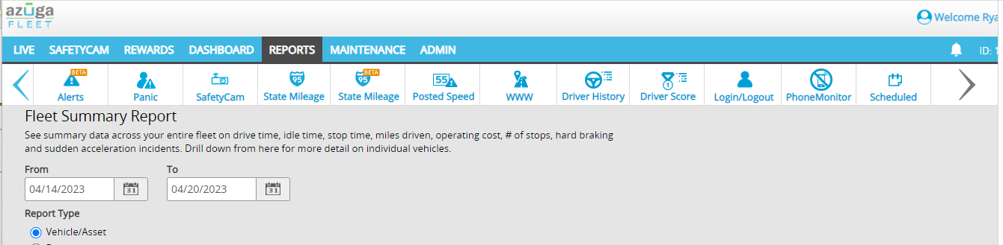

Detail Reports
Easly to run a ton of reports: Breadcrumb, Trips, Fleet Summary, Geofence, Speeds etc:

Slide 15
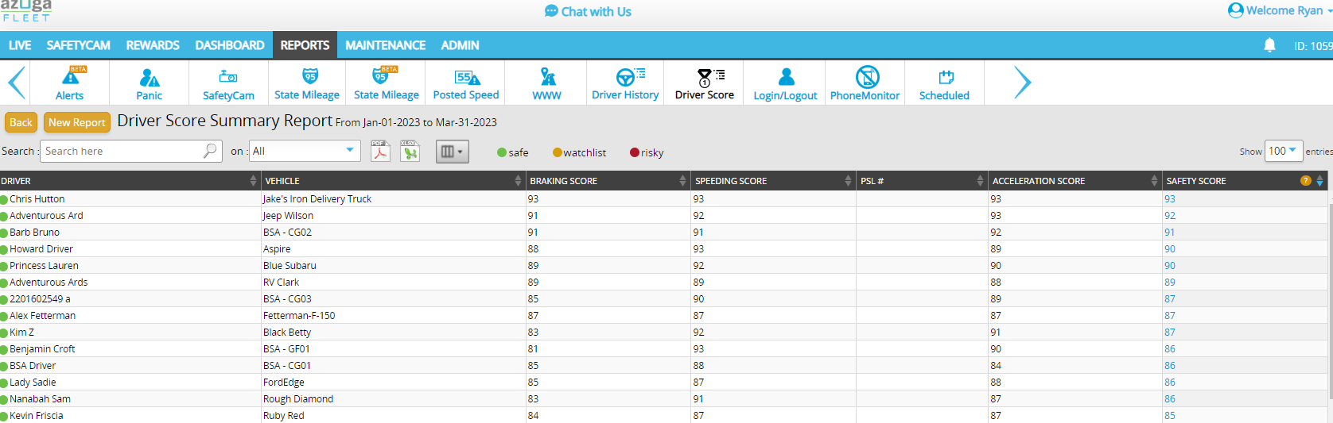
Driver Dashboard
Our AI Media tab makes it easy to evaluate your fleet
TOP GOOD DRIVERS = Reward Them

Slide 16
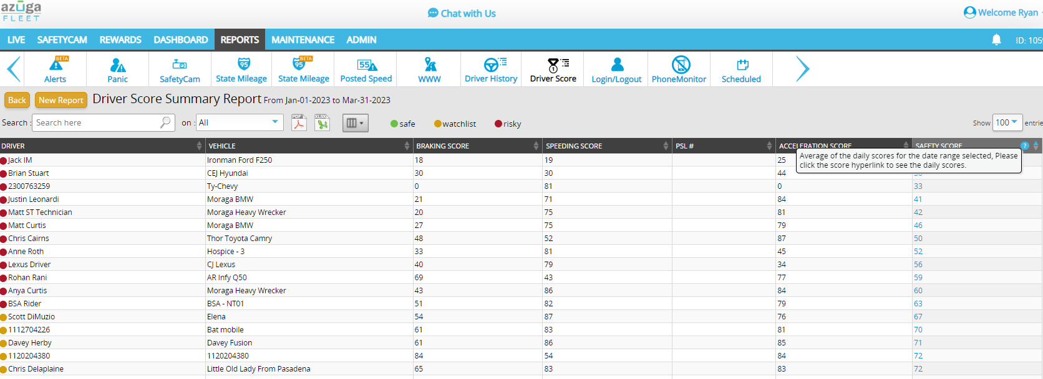
Driver Dashboard
Our AI Media tab makes it easy to evaluate your fleet
TOP BAD DRIVERS – Coach Them
AVERAGE of the Daily Scores for the Data Range selected. This was Jan 1 2023 – March 31 2023

Slide 17
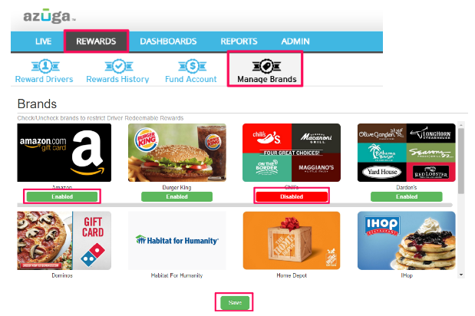
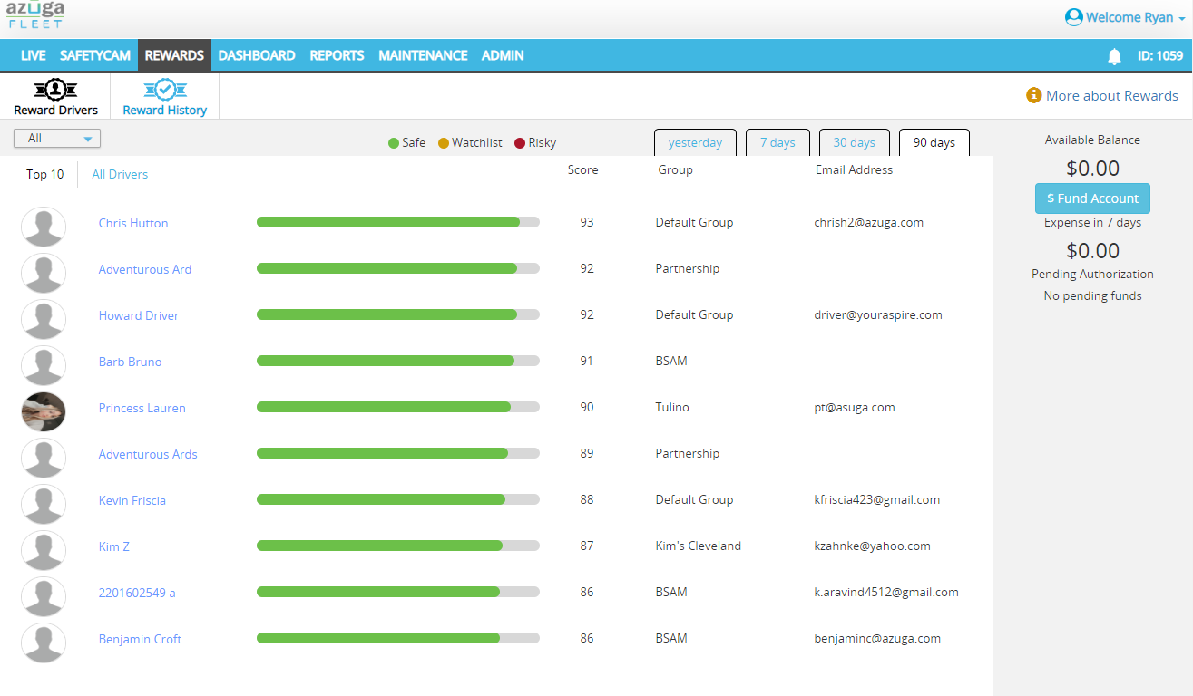
Driver Rewards
The Driver Rewards Program is an initiative that aims to change the relationship between fleet owners and drivers. POSITIVE RENFORCEMENT!
This feature helps fleet managers easily reward their best-performing drivers.

Slide 18
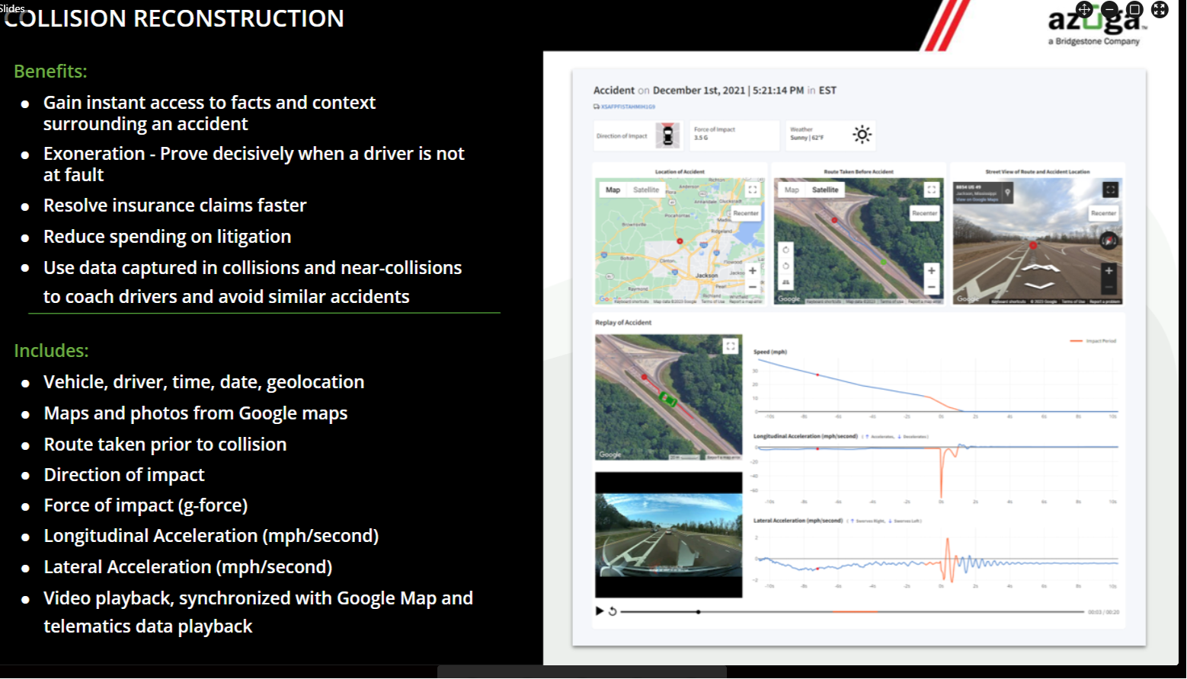

Slide 19
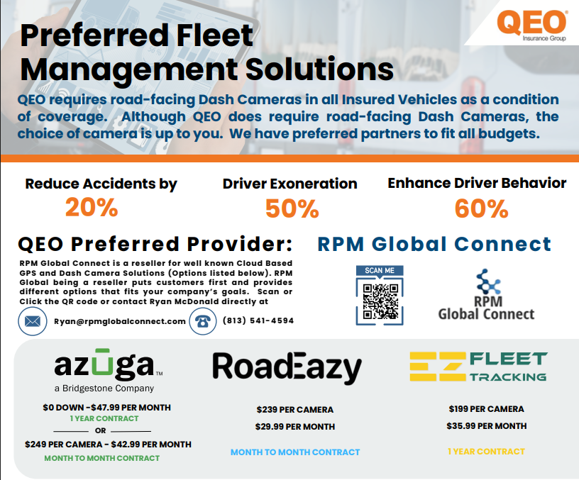


QEO’s Camera Marketing:

Slide 20
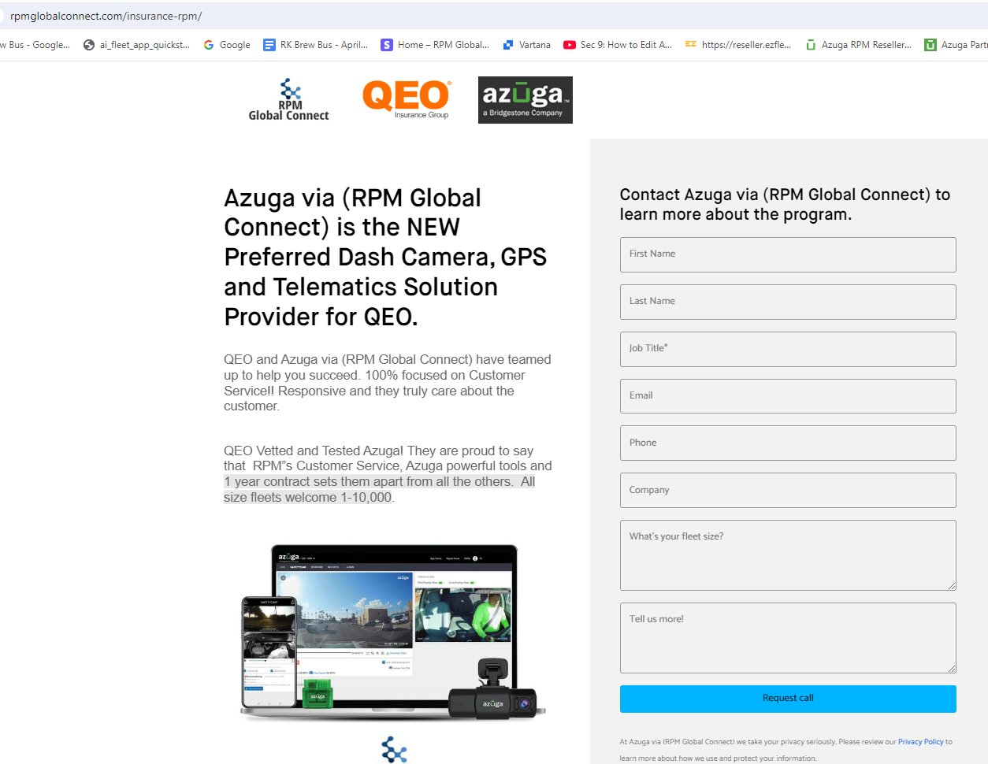
Landing Page:

Slide 21
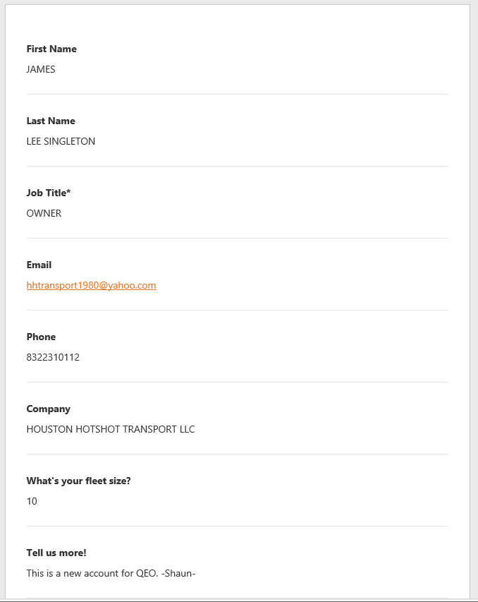
Generates
E-mail:

Slide 22
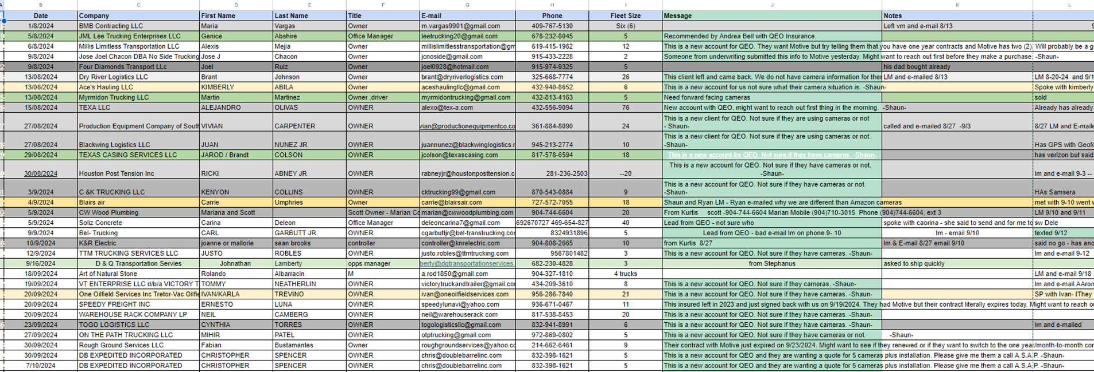
Landing Page:

Slide 23
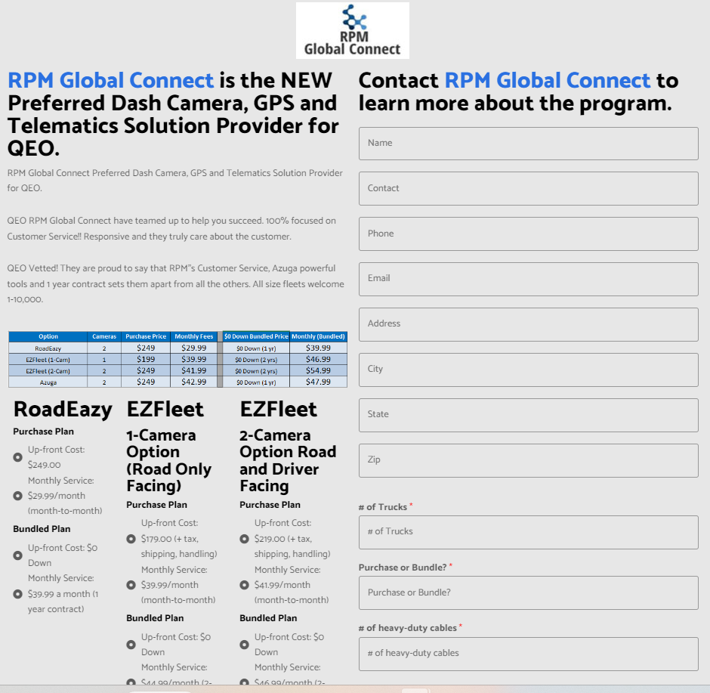

New Insurance Landing Page:

Slide 24
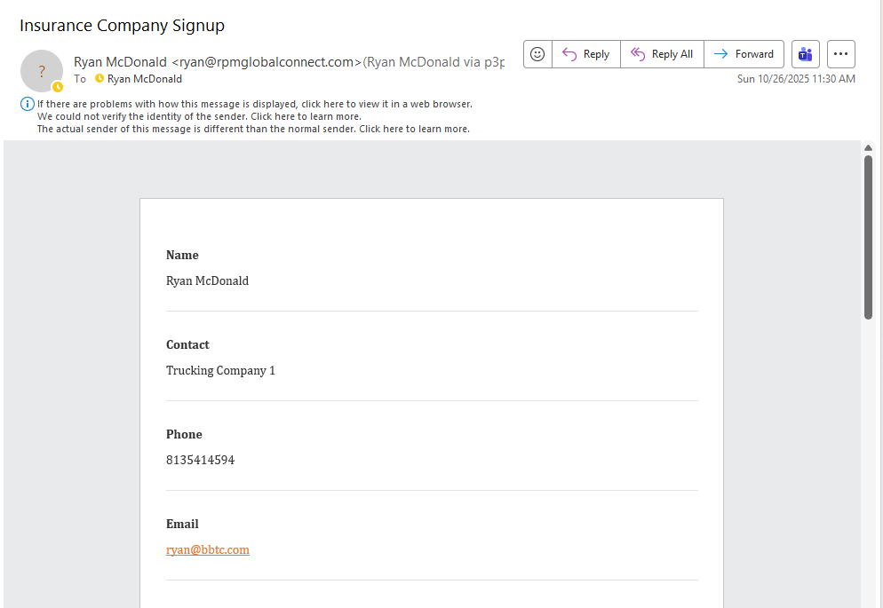
Generates e-mail:

Slide 25
Landing Page:

Slide 26

1. Created an easy-to-use QR Code

Slide 27
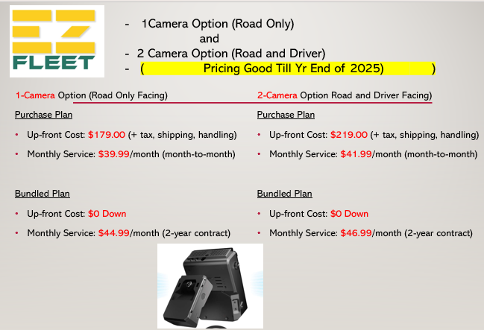
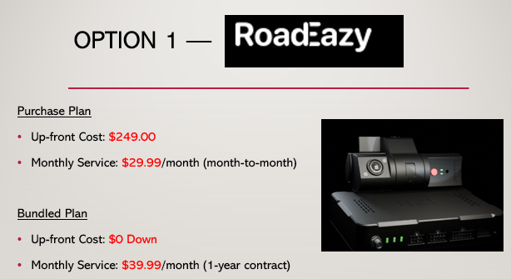
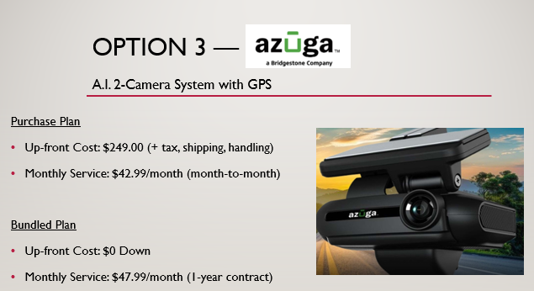
Pricing:

Slide 28
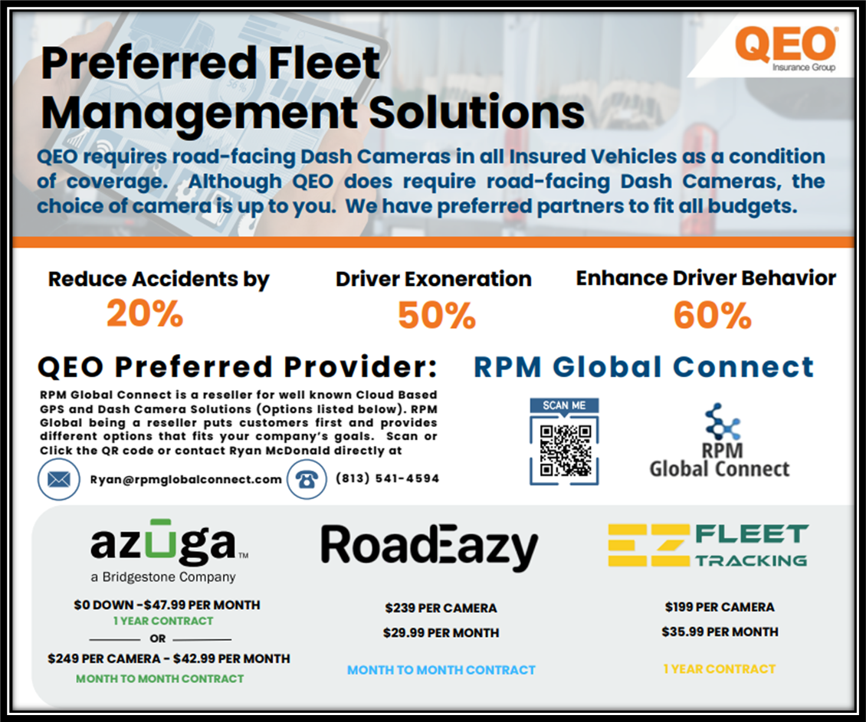
Suggested Implementation:
1. Create a custom – 1 sheet – similar to the QEO sample
2. Send an E-mail, exampled below, to potential customers who inquire or need cameras.
3. RPM to track and help communicate - Responses

Slide 29
Questions?
Ryan McDonald 10/29/2025

